Slide 1
INTEGRATED HOTEL MANAGEMENT SYSTEM
A Database-Driven Solution for Managing Hotel Operations

Slide 2
INTRODUCTION
The Integrated Hotel Management System is a database-based system designed to manage hotel operations such as guest details, room availability, reservations, payments, and staff information. The project uses SQL to store and organize data efficiently, ensuring accuracy, consistency, and easy retrieval of information. This system provides a structured approach to hotel data management and supports effective decision-making through reliable database operations.

Slide 3
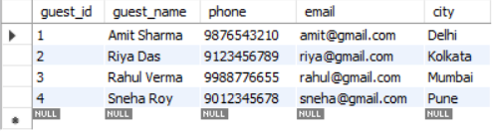
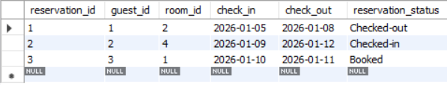
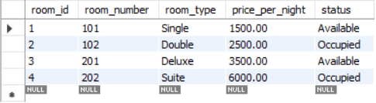

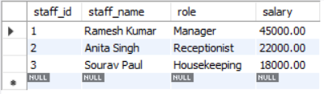
DATASET
Guest Table
Reservation Table
Rooms Table
Payments Table
Staff Table

Slide 4
PROBLEM STATEMENT
List all guests
Show available rooms
Count total guests
Show occupied rooms
Show all reservations with guest names
Total revenue generated
Average room price
Payment details with guest name
Highest priced room
Reservations count per room type
Guests who made payments
Occupancy rate of hotel
Revenue by room type
Highest paying guest
Guests staying more than 2 days
Rooms never booked
Total staff salary
Highest paid staff member
Number of stays per guest
Monthly revenue

Slide 5
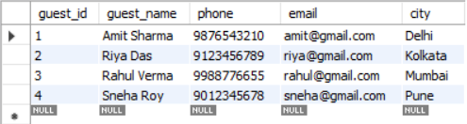

DATA EXTRACTION QUERIES
1. List all guests
Displays the complete list of all registered guests.
Helps verify guest data before performing further analysis.
2. Count total guests
This query provides the total number of guests stored in the system, helping to understand overall customer volume.
The result can be used to analyze business growth and support capacity planning and reporting.

Slide 6




DATA EXTRACTION QUERIES
3. Show available rooms
This query shows rooms that are currently available for new bookings.
WHERE clause – used to filter rooms based on availability status (status = 'Available').
4. Show occupied rooms
This query identifies all rooms that are currently occupied.
It helps monitor room utilization and manage availability effectively.

Slide 7

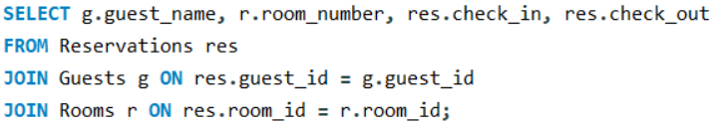

DATA EXTRACTION QUERIES
5. Show all reservations with guest names
This query displays reservation details along with the corresponding guest names and room numbers.
It helps track guest stay periods by showing check-in and check-out dates.
6. Total revenue generated
Shows the total revenue earned.
Helps track overall hotel income.

Slide 8

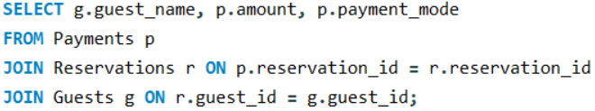

DATA EXTRACTION QUERIES
7. Average room price
Shows the average price of all rooms per night.
Helps understand pricing trends and set competitive rates
8. Payment details with guest name
Displays payment amounts and methods along with guest names.
Helps track who paid and how, for easy financial management.

Slide 9

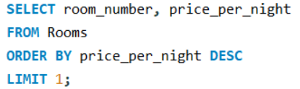

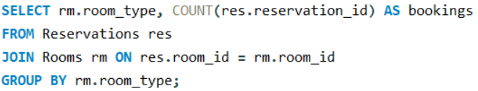
DATA EXTRACTION QUERIES
9. Highest priced room
Shows the room with the highest price per night.
Helps identify premium rooms for marketing or special bookings.
10. Reservations count per room type
Shows how many reservations were made for each room type.
Helps identify the most and least popular room categories.

Slide 10

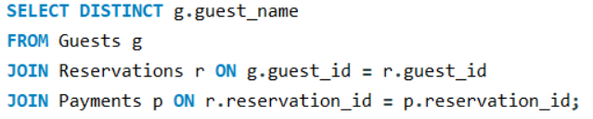

DATA EXTRACTION QUERIES
11. Guests who made payments
Identifies guests who have successfully made payments.
Helps distinguish paying guests for financial tracking and reporting.
12. Occupancy rate of hotel
Shows the percentage of rooms currently occupied in the hotel.
Helps evaluate room utilization and overall hotel performance.

Slide 11

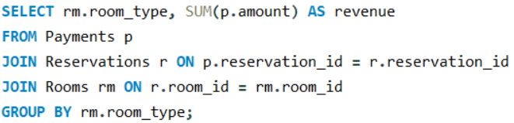

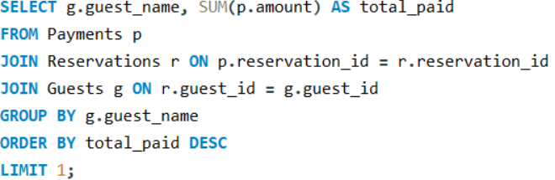
DATA EXTRACTION QUERIES
13. Revenue by room type
Shows how much revenue is generated by each room type.
Helps identify the most profitable room categories.
14. Highest paying guest
Identifies the guest who has paid the highest total amount.
Helps recognize high-value guests for loyalty or premium services.

Slide 12

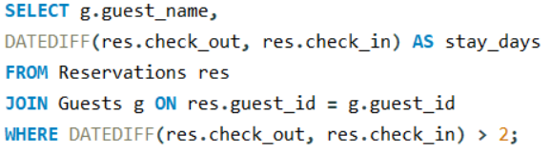

DATA EXTRACTION QUERIES
15. Guests staying more than 2 days
Identifies guests who stayed for more than two days.
Helps analyze long-stay guests for targeted offers or discounts.
16. Rooms never booked
Identifies rooms that have never been booked.
Helps spot underutilized rooms for promotions or pricing review.

Slide 13


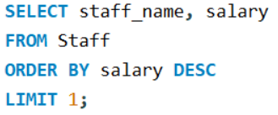
DATA EXTRACTION QUERIES
17. Total staff salary
Shows the total salary expense for all staff members.
Helps monitor payroll costs and manage the hotel budget.
18. Highest paid staff member
Identifies the staff member with the highest salary.
Helps analyze salary distribution and compensation structure.

Slide 14
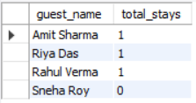
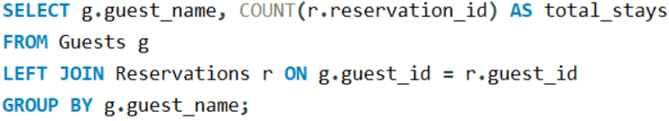


DATA EXTRACTION QUERIES
19. Number of stays per guest
Shows how many times each guest has stayed at the hotel.
Helps identify repeat guests and loyal customers.
20. Monthly revenue
Shows the total revenue generated in each month.
Helps identify monthly trends and seasonal performance.

Slide 15
CHALLENGES FACED:
FUTURE ENHANCEMENT:
Designing proper relationships between all tables using primary and foreign keys
Managing room availability and avoiding double bookings
Keeping guest, reservation, and payment data accurate and consistent
Writing JOIN and aggregate queries for reports and insights
Handling date-based calculations like stay duration and monthly revenue
Add user roles and login authentication for secure system access
Implement real-time room availability updates and booking validation
Include automated billing, invoices, and tax calculations
Add cancellation, refund, and discount management features
Generate advanced reports and dashboards for better decision-making

Slide 16
CONCLUSIONS:
The Hotel Management System project successfully demonstrates the use of SQL to design a structured database and manage hotel operations efficiently. By organizing data into related tables and using queries, the system provides meaningful insights on guests, rooms, reservations, revenue, and staff. This project highlights practical database skills such as table creation, relationships, joins, and aggregate functions, making it a strong foundation for real-world hotel management applications.

Slide 17
THANK YOU !!

